Slide 1

A Major Project
on
FABRICATION OF SURVEILLANCE QUADCOPTER
DEPARTMENT OF MECHANICAL ENGINEERING
LENDI INSTITUTE OF ENGINEERING & TECHNOLOGY
BATCH -20
REG.NO | NAME
19KD1A0363 | R SRINU
19KD1A0368 | S JAYA BHARADWAJ
19KD1A0371 | S BHARATH KUMAR
19KD1A0377 | T JAIDEEP
19KD1A0378 | T SRIKAR
Under the guidance of
Dr.Satish Pujari M.E, PhD
Professor&HOD

Slide 2
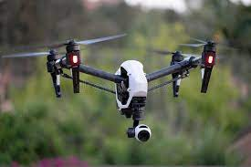
ABSTRACT
A surveillance quadcopter is a small unmanned aerial vehicle (UAV) that is equipped with cameras, sensors, and other technologies to collect and transmit data in real-time.
Surveillance quadcopters have become increasingly popular in various industries, including military, law enforcement, disaster management, search and rescue, and others, due to their ability to provide critical information quickly and efficiently.

Slide 3
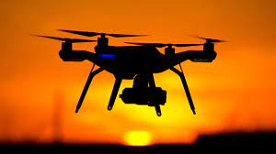
INTRODUCTION
Surveillance quadcopters are unmanned aerial vehicles (UAVs) that are used to monitor and record activity from the sky.
They have become increasingly popular in recent years due to their ability to provide high-quality footage without the need for a human pilot.
Quadcopters are equipped with a variety of sensors and cameras to capture a wide range of data, making them perfect for surveillance purposes.

Slide 4
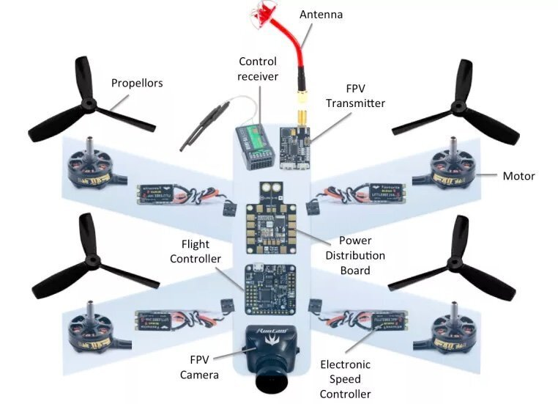
COMPONENTS

Slide 5
Working principle :
The working principle of a surveillance quadcopter involves several essential components working together to ensure proper flight and data collection. The main components of a surveillance quadcopter include:
Frame: The frame of the quadcopter is designed to provide stability and support to the other components.
BLDC Motors and propellers: The motors and propellers are responsible for the lift and movement of the quadcopter. The motors are controlled by an electronic speed controller (ESC) that receives signals from the flight controller.
Flight controller: The flight controller is the brain of the quadcopter, responsible for controlling the motors and stabilizing the quadcopter during flight.

Slide 6
4.Sensors: Sensors such as accelerometers, gyroscopes, and magnetometers provide information about the quadcopter's orientation, speed, and location.
5.GPS: The GPS system provides the quadcopter's location and helps to navigate it to specific locations.
6.Cameras and other sensors: The cameras and other sensors mounted on the quadcopter are used to collect data such as images, videos, and other information.
NOTE:During operation, the flight controller receives signals from the sensors and GPS to stabilize and navigate the quadcopter. The quadcopter's cameras and other sensors collect data and transmit it back to the ground station, where it can be analyzed and used for various purposes.

Slide 7
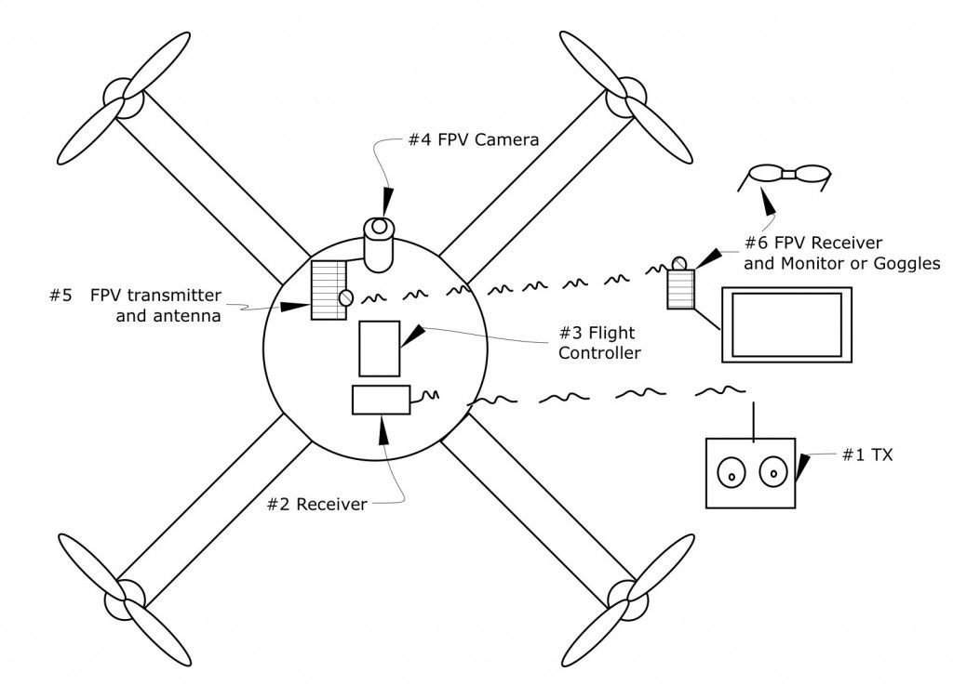

Slide 8
ADVANTAGES
More efficient inspections.
Conducting scientific research.
Facilitates deliveries.
Rescue operations.
Military applications.
Video and photo capture.

Slide 9
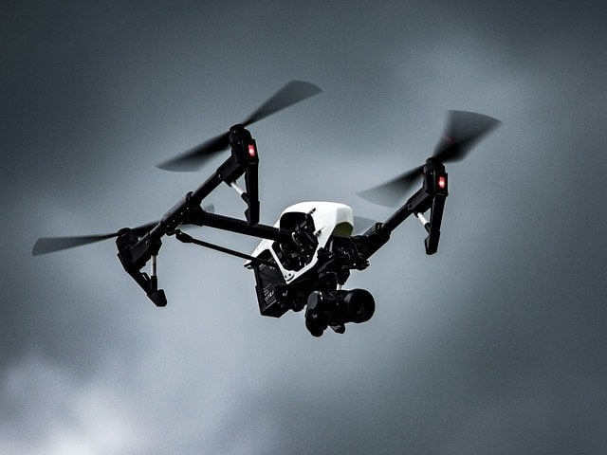
APPLICATIONS
Military and defense
Law enforcement
Search and rescue
Agriculture.
Infrastructure inspection
Environmental monitoring
Film and media production

Slide 10
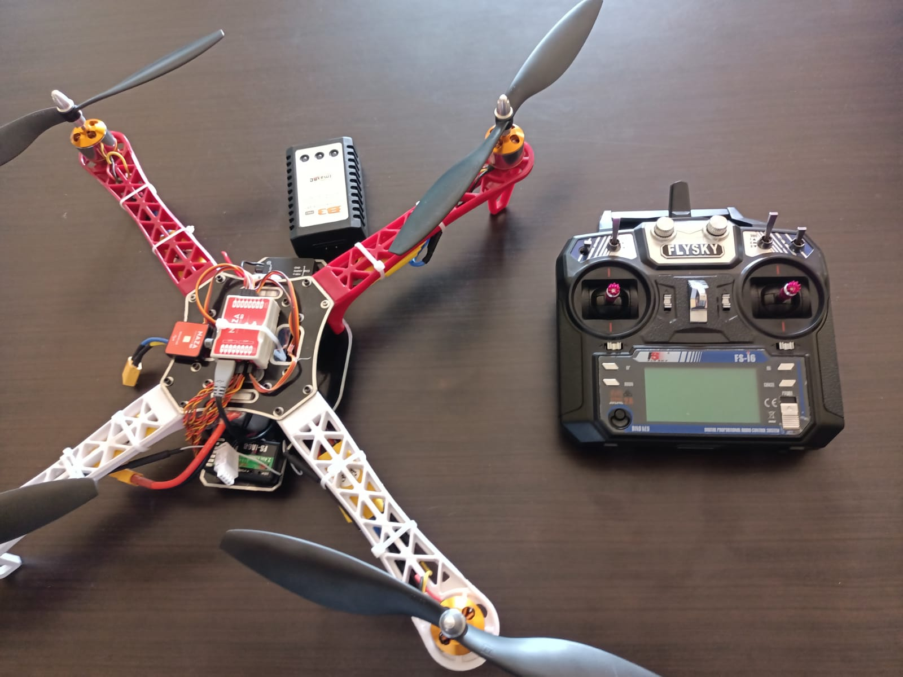
FINAL OUTPUT

Slide 11
RESULT
The surveillance quadcopter project with low cost and improved performance was a great success. The project aimed to design and build a quadcopter drone equipped with a camera for surveillance purposes while keeping the overall cost low and improving the performance of the drone.
The remote control system was also upgraded with additional features, including improved signal strength and range, making it suitable for use in more challenging environments.

Slide 12
CONCLUSION:
surveillance quadcopters are rapidly emerging as a powerful tool for data collection and analysis across various industries. Their ability to fly autonomously, navigate to specific locations, and collect data in real-time makes them an attractive option for various applications
The future prospects of surveillance quadcopters are promising. As new technologies and applications are developed, surveillance quadcopters are expected to become even more efficient, effective, and versatile.

Slide 13


